Slide 1

AnalyZing Black Friday Sales
BCIS 5110.012 Programming Languages For Business Analytics
Project Group-2

Slide 2

INTRODUCTION
The Black Friday sales event stands as a pivotal moment in the retail calendar, attracting a massive influx of shoppers eager to capitalize on lucrative deals. This report delves into the rich dataset sourced from Kaggle, offering a comprehensive analysis of Black Friday sales. The primary objectives are to unravel consumer trends, dissect purchasing behavior, and evaluate retailer strategies during this annual shopping extravaganza.

Slide 3

About Data Set
The dataset is called “Black Friday Sales EDA” which has sales data of purchases made by customer. Dataset contains customer demographic info, product details and total purchase amount. This data set fulfills all the requirements necessary for this project.
• There are 550068 rows, and 12 columns present in the data set.
• There are three data types across the columns: integer, float, object.
• There are 5-10% missing values in two columns. Reference:
https://www.kaggle.com/datasets/pranavuikey/black-friday-sales-eda

Slide 4
Research Questions:
What age group has the highest and lowest purchases?
What gender is the top buyer on Black Friday?
What city category accounts for the most and least purchases?
Does marital status have any impact on purchase?
Which occupation category has the most and least purchase?

Slide 5
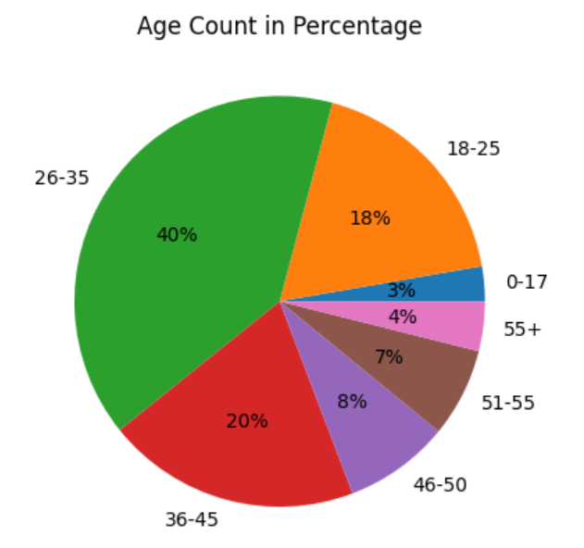
What age group has the highest and lowest purchases?

Slide 6
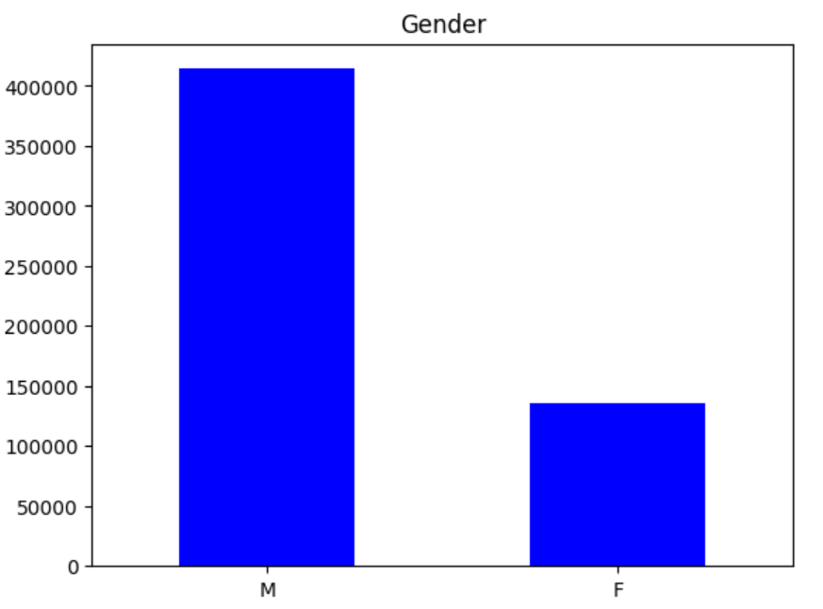
What gender is the top buyer on Black Friday?

Slide 7
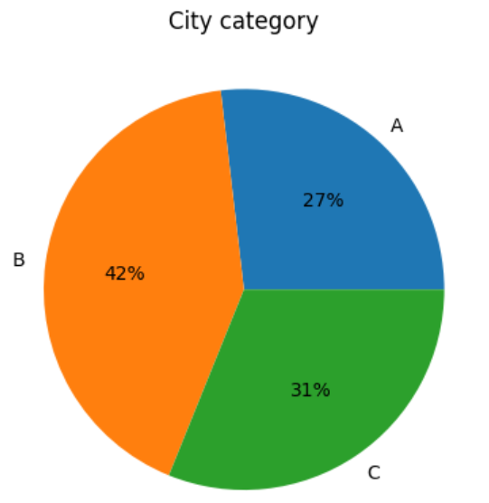
What city category accounts for the most and least purchases?

Slide 8
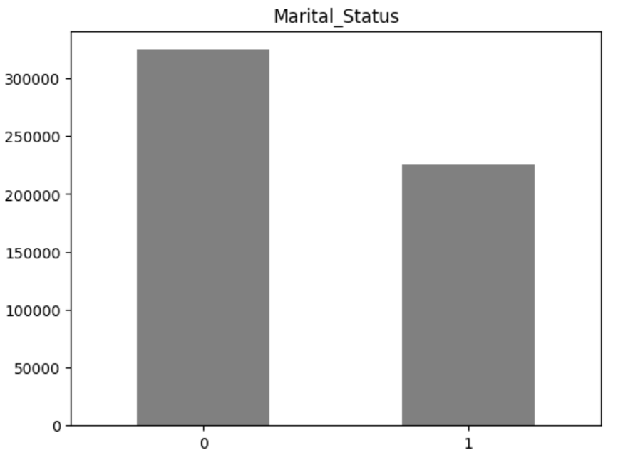
Does marital status have any impact on purchase?

Slide 9
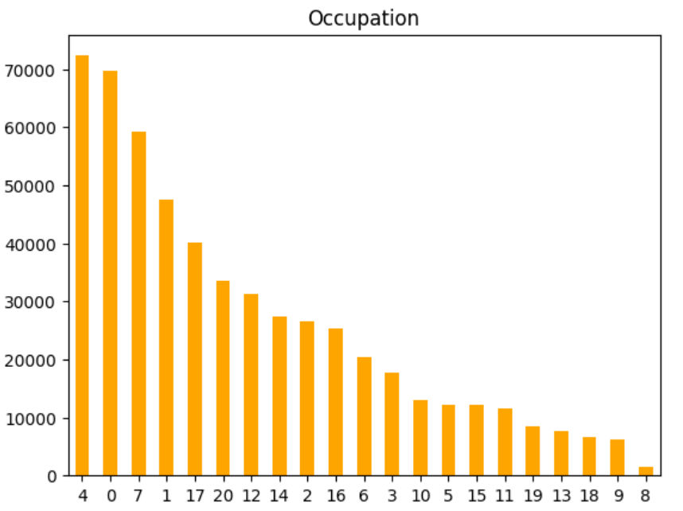
Which occupation category has the most and least purchase?

Slide 10

Conclusion
By unraveling the dynamics of Black Friday sales, this project seeks to contribute valuable insights to retailers, marketers, and industry stakeholders. In a rapidly evolving retail landscape, understanding the nuances of consumer behavior and optimizing retail strategies are critical for success. Through this analysis, we aim to shed light on the factors that drive Black Friday success and provide practical recommendations for stakeholders navigating the challenges and opportunities of this extraordinary sales event.

